Slide 1


Demo 1
CPSC 233 Group 25

Slide 2

Show of Hands

Slide 3


Slide 4
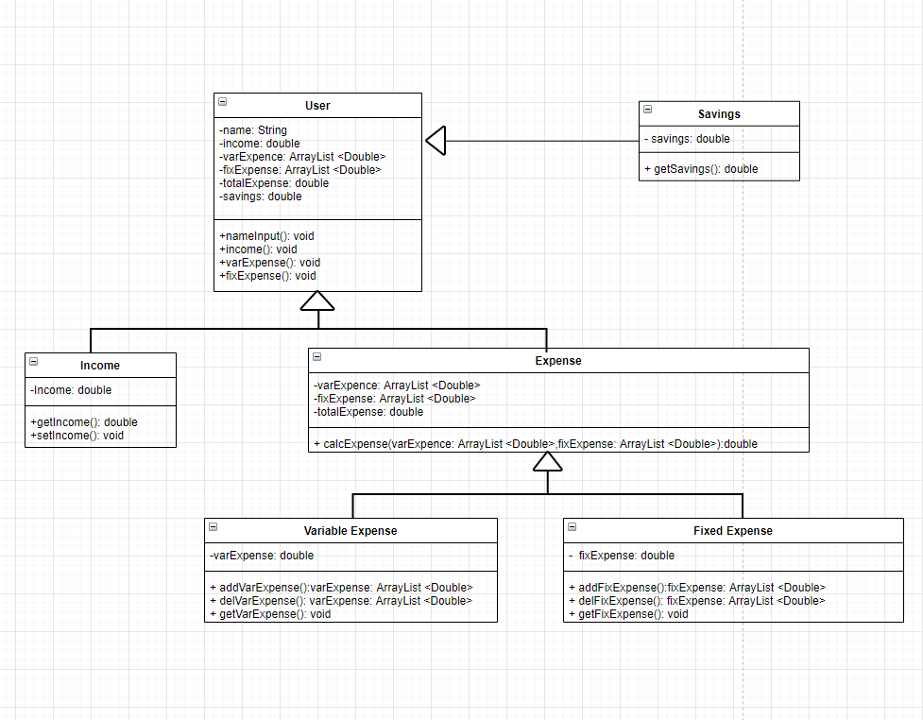
UML
Text base iteration
Prompt User for data
Preforms functions

Slide 5
USER CLASS

Slide 6
Income CLASS

Slide 7
Expense CLASS

Slide 8
Fixed and Variable Expense

Slide 9
SAVINGS CLASS

Slide 10
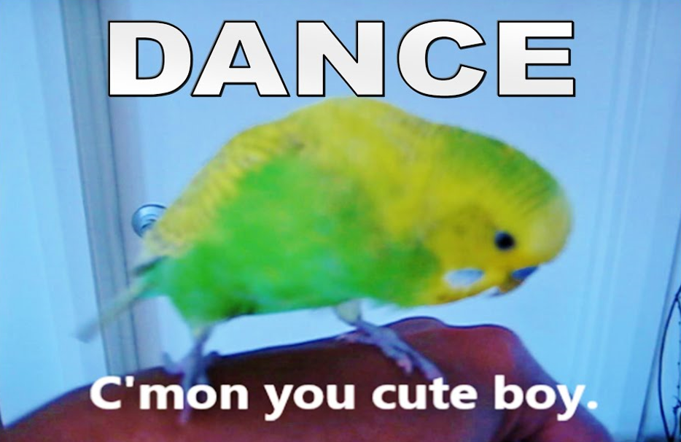
Thanks for Listening

